Slide 1
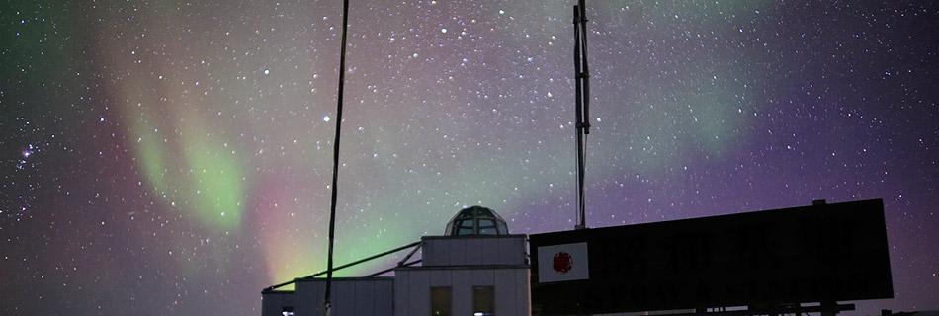
Observations of various atoms and molecules in the THz region
~ Mainly from astrochemical aspect ~
Shuro Takano
(College of Engineering, Nihon Univ.)

Slide 2
Contents
Characteristics of the Terahertz region
  For atoms and molecules
  Observable species and their nature
Potentially Interesting lines mainly after my talk in 2015 (update)
  Protonated noble gas (HeH⁺, …)
  Slow vibration (long carbon-chain molecules)
Summary

Slide 3
Characteristics of the Terahertz region
Atomic and molecular lines
  High-excitation lines
    Even for CO
    Heavy organic molecules: Should be relatively weak
  Light molecules (→small moment of inertia):
  H₂D⁺, HD₂⁺, CH, CH⁺, NH, OH, OH⁺, H₂O, H₂O⁺, NH₃,,,
  Atomic (fine structure) lines : C, N⁺, O, …
HeH⁺, ArH⁺
  Slow vibrations: Carbon-chain molecules

Slide 4
Typical spectral lines in the THz region
Hydrogen related
  H (recombination), H₂D⁺, HD₂⁺
Carbon related
  C, C⁺, CH, CH⁺, CH₂, …
Nitrogen related
  N⁺, N²⁺, NH, NH₂, NH₃, …
Oxygen related
  O, O²⁺, OH, OH⁺, H₂O, H₂O⁺ , …

Slide 5
Typical spectral lines in the THz region
Hydrogen related
  H (recombination) many
  H₂D⁺ 372.42138 GHz, 1( 1, 0)- 1( 1, 1), 104.2 K (CDMS)
  1370.08488 GHz, 1( 0, 1)- 0( 0, 0), 65.8 K
  HD₂⁺ 691.66048 GHz, 1( 1, 0)- 1( 0, 1), 83.4 K (CDMS)
  1370.05160 GHz, 2( 2, 0)- 2( 1, 1), 261 K
  1476.60571 GHz, 1( 1, 1)- 0( 0, 0), 70.9 K
  (203 μm)
E(upper)
Recently detected (SOFIA, Harju et al. 2017)

Slide 6
Typical spectral lines in the THz region
Yasuda-san’s talk
Carbon related
  C 492.16065 GHz, ³P₁ - ³P₀, 23.6 K (CDMS)
  809.34197 GHz, ³P₂ - ³P₁, 62.5 K
  C⁺ 1900.53690 GHz, ²P_{3/2} - ²P_{1/2}, 91.2 K (CDMS) (158 μm)
  CH 536.76115 GHz etc., N= 1, J=3/2-1/2, F= 2⁻- 1⁺, 25.8 K
  1470.73960 GHz etc., N= 2, J=3/2-3/2, F= 2⁺- 2⁻, 96.3 K
  (CDMS)
  CH⁺ 835.13750 GHz, 1- 0, 40.1 K (CDMS)
  1669.28129 GHz, 2- 1, 120 K

Slide 7
Typical spectral lines in the THz region
Carbon related
  CH₂ 444.82569 GHz etc., 2( 1, 2)- 3( 0, 3), J= 3- 4, F= 3- 4, 156 K
  581.27527 GHz etc., 5( 0, 5)- 4( 1, 4), J= 4- 4, F= 4- 4, 336 K
  945.83935 GHz etc., 1( 1, 1)- 2( 0, 2), J= 2- 3, F= 3- 4, 113 K (CDMS)

Slide 8
Typical spectral lines in the THz region
Nitrogen related
  N No lines (⁴S: no splitting)
  N⁺ 1461.13141 GHz, ³P₁-³P₀ (205 μm)(SLAIM)
  2459.38010 GHz, ³P₂-³P₁
  N²⁺ (NIII) 5230.43 GHz, ³P_{3/2}-³P_{1/2} (from the former table)
  NH 946.47582 GHz etc., N= 1- 0, J= 0- 1, 45.4 K (JPL)
  974.47861 GHz etc., N= 1- 0, J= 2- 1, 46.8 K
  999.97339 GHz etc., N= 1- 0, J= 1- 1, 48.0 K
  NH₂ many lines
  NH₃ 572.49816 GHz, 1( 0)0s- 0( 0)0a, 27.5 K (pure rotation)
  1168.45239 GHz, 2( 1)0s- 1( 1)0a, 79.3 K (JPL)
Umemoto-san’s talk
added

Slide 9
Typical spectral lines in the THz region
Oxygen related
  O 2060.06800 GHz, ³P₁-³P₀, 326 K (JPL) (145 μm)
  4744.77 GHz, ³P₂-³P₁ (from the former table)
  O⁺ No lines (⁴S: no splitting)
  O²⁺ (OIII) 3392.66 GHz, ³P₁-³P₀ (from the former table)
  5785.82 GHz, ³P₁-³P₀ (from the former table)
  OH 1837.8168 GHz etc., J=3/2-1/2, Ω=1/2,F= 2⁺- 1⁻, 270 K (JPL)
  OH⁺ 909.15880 GHz, N= 1- 0, J= 0- 1, F=1/2-3/2, 43.6 K
  971.80530 GHz, N= 1- 0, J= 2- 1, F=3/2-1/2, 46.6 K
  1032.9979 GHz, N= 1- 0, J= 1- 1, F=1/2-1/2, 49.6 K (CDMS)
added
Hashimoto-san’s talk
added
added

Slide 10
Typical spectral lines in the THz region
Oxygen related
  H₂O many lines (JPL)
  H₂O⁺ many lines (CDMS)
  H₃O⁺ 307.19241 GHz, 1( 1)- 2( 1), 0⁻ - 0⁺, 79.5 K (JPL)
  364.79743 GHz, 3( 2)- 2( 2), 0⁺ - 0⁻, 140 K
  388.45864 GHz, 3( 1)- 2( 1), 0⁺ - 0⁻, 162 K
  396.27241 GHz, 3( 0)- 2( 0), 0⁺ - 0⁻, 169 K
  984.71191 GHz, 0( 0)- 1( 0), 0⁻ - 0⁺, 54.6 K
  1031.29374 GHz, 4(-3)- 3( 3), 0⁺ - 0⁻, 232 K
  1069.82663 GHz, 4( 2)- 3( 2), 0⁺ - 0⁻, 269 K
  1092.52314 GHz, 4( 1)- 3( 1), 0⁺ - 0⁻, 291 K

Slide 11
Science cases in the THz region
Trace basic processes of H, C, N, O reactions
  Including Deuterium concentration processes
CH, OH⁺, H₂O⁺: XDR (X-ray dominated region) tracers?
CH⁺ and shock
Atoms
  C
  Red-shifted C⁺ line
  N⁺
  Red-shifted O line
Red-shifted OIII !!

Slide 12
Basic gas-phase processes of C, N, O reactions
Carbon network (Red species → THz lines)
C⁺ + H₂ ----> CH⁺ + H (endothermic 4640 K)
----> CH₂⁺ (radiative association)
CH⁺ + H₂ → CH₂⁺ + H
CH⁺ + e- → C + H
CH₂⁺ + H₂ → CH₃⁺ + H
CH₂⁺ + e- → CH + H
CH₃⁺ + H₂ ----> CH₅⁺ (radiative association)
CH₃⁺ + e- → CH₂ + H
CH₅⁺ + e- → CH₄ (methane) + H
→ CH₃ + H₂
CH₄ can also be produced on grain.

Slide 13
Basic gas-phase processes of C, N, O reactions
Nitrogen network (Red species → THz lines)
N⁺ + H₂ ----> NH⁺ + H (endothermic 209 K, e.g., Marquette et al. 1988)
NH⁺ + H₂ → NH₂⁺ + H
NH⁺ + e- → N + H
NH₂⁺ + H₂ → NH₃⁺ + H
NH₂⁺ + e- → NH + H
→ N +H₂
NH₃⁺ + H₂ → NH₄⁺ + H
NH₃⁺ + e- → NH₂ + H
→ NH + H₂
NH₄⁺ + e- → NH₃ (ammonia) + H
→ NH₂ + H₂
→ NH + H₂ +H
NH₃ is mainly produced on grain (e.g., Herbst et al. 1987, Hidaka et al. 2011)

Slide 14
Basic gas-phase processes of C, N, O reactions
Oxygen network (Red species → THz lines)
O⁺ + H₂ → OH⁺ + H
OH⁺ + H₂ → H₂O⁺ + H
OH⁺ + e- → O + H
H₂O⁺ + H₂ → H₃O⁺ + H
H₂O⁺ + e- → OH + H
→ O + H₂
H₃O⁺ + e- → H₂O (water) + H
Water is also produced on grain (e.g., Ioppolo et al. 2010)

Slide 15
Processes of deuterium concentration
(Red species → THz lines)
H₂ + H₂⁺ → H₃⁺ + H
HD + H₃⁺ → H₂D⁺ + H₂ (230 K exothermic)
HD + H₂D⁺ → HD₂⁺ + H₂ (180 K exothermic)
(Vastel et al. 2004)
➔ D is introduced to molecules via H₂D⁺ and HD₂⁺.
Almost free from depletion
In addition to study D fractionation, good tool to study physical and chemical conditions
Observations of these red species:
Supply information on these fundamental initial processes

Slide 16
Contents
Characteristics of the Terahertz region
  For atoms and molecules
  Observable species and their nature
Potentially Interesting lines mainly after my talk in 2015
  Protonated noble gas
  Slow vibration
Summary

Slide 17
HeH⁺ in the THz region
“The chemistry of the Universe began with this ion.” (Güsten et al. 2019)
Probe of early universe
Noble gas tracer
J =1-0 at 2.01 THz (149 μm)
Long trials to detect: NIR, THz (ISO)
NGC 7027: Planetary nebula
Detected with SOFIA + upGREAT (beam 14.3 arcsec)
HeH⁺
CO
(x0.04)

Slide 18
HeH⁺ in the THz region
Fundamental reaction rates
Peak abundance: HeH⁺ / H = 4.0 x 10⁻⁸

Slide 19
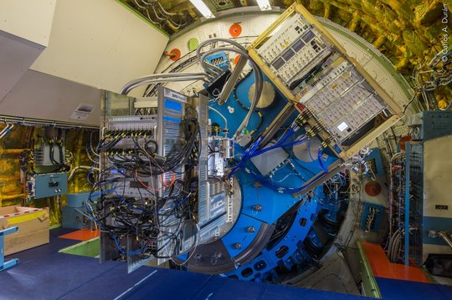
HeH⁺ in the THz region
The GREAT far-infrared spectrometer is mounted to the telescope flange of the flying observatory SOFIA, inside the pressurized cabin.
© Carlos Duran/MPIfR.

Slide 20
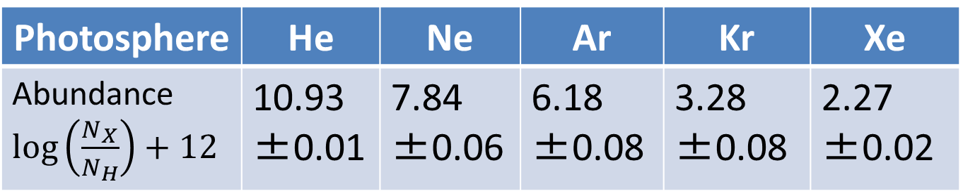
Other noble gas ion?
Noble gas: He, Ne, Ar, Kr, Xe
  NeH⁺ (J=1-0) 1039.3 GHz: Not detected
    [NeH⁺] / [ArH⁺] ≤ 0.1 (Schilke et al. 2014)
  ³⁶ArH⁺
    On the Earth, ⁴⁰Ar is the main isotope
    ⁴⁰K (in rocks) → ⁴⁰Ar (β decay: 1.248x10⁹ yr)
    In Interstellar space, ³⁶Ar is the main
Photosphere | He | Ne | Ar | Kr | Xe
Abundance$\log\left(\frac{N_{X}}{N_{H}}\right)+12$ | 10.93±0.01 | 7.84 ±0.06 | 6.18 ±0.08 | 3.28 ±0.08 | 2.27 ±0.02
Indirect estimates, Asplund et al. (2006)

Slide 21
Other noble gas ion?
³⁶ArH⁺ in the THz region (Barlow et al. 2013)
J = 1-0 at 0.6175 THz,
J = 2-1 at 1.234 THz
Crab Nebula: SNR (1054 AD)
Detected with Herschel + SPIRE (FTS)
  Beam size: ~37, ~18 arcsec
  Freq. resolution: 1.44 GHz

Slide 22
Other noble gas ion?
³⁶ArH⁺ in the THz region (Barlow et al. 2013)
J = 1-0 at 0.6175 THz, J = 2-1 at 1.234 THz
J = 1-0
J = 2-1

Slide 23
Other noble gas ion?
³⁶ArH⁺ in the THz region
Ubiquitous in diffuse interstellar medium (Schilke et al. 2014)
  A molecular tracer of almost purely atomic gas!!
  ArH⁺ + H₂ → Ar + H₃⁺ is exothermic (rapid)
Protonated noble gas ➔ Unique probes
  First chemical bond in the early universe
  Abundance and behavior of noble gases in low excitation

Slide 24



Ro-vibrational transitions in the THz region
Ro-vibrational transitions: Generally at IR region
  Slow vibration (large amplitude motion) comes to THz!
$$v=1$$
J=3
J=2
J=1
J=0
$$v=0$$
J=3
J=2
J=1
J=0
P branch Q branch R branch
$$ΔJ=−1 ΔJ=0 ΔJ=+1$$

Slide 25
Ro-vibrational transitions in the
THz region: C₃
Example: C₃ molecule (Giesen et al. 2019, arXiv: 1911.0975)
”¹³CCC & C¹³CC isotopologues towards SgrB2(M)”
SOFIA+GREAT or upGREAT: ¹³CCC, C¹³CC at 1.9 THz
Herschel HIFI: CCC at 1.6-1.9 THz
¹³CCC
¹³CCC
Bending
mode

Slide 26
Ro-vibrational transitions in the
THz region: C₃
Example: C₃ molecule (Giesen et al. 2019, arXiv: 1911.0975)
¹²C/¹³C = 20.5±4.2 (close to the elemental ratio of 20)
¹³C isotopic fractionation found:
N(¹³CCC) / N(C¹³CC)
= 1.2±0.1 (smaller than 2)
➔Difference in zero-point
energies

Slide 27
Ro-vibrational transitions in the THz region
Slow vibration can happen for:
internal rotation, inversion, puckering, pseudo rotation, bending of quasi-linear molecule, & torsion of cage, etc. (e.g., Egawa & Kuchitsu, 1988)
Long molecules: (1 cm⁻¹ ≈ 30 GHz)
  C₅ (118±3 cm⁻¹), C₆ (90±50 cm⁻¹), C₇ (496±100
  cm⁻¹), ... (ref. NIST webbook)
  HC₄H (220 cm⁻¹), HC₆H (105 cm⁻¹), ...
  (ref. Jolly & Benilan 2008)
➔ Explore carbon-chain molecules with no dipole moment in relatively low excitation

Slide 28
Carbon-chain (~40% of interstellar molecules) formation: Cyanopolyynes HC₃N, HC₅N, HC₇N,…
HC₃N: ¹³C fractionation (TMC-1 with NRO 45m, Takano et al. 1998)
➔ C₂H₂ + CN
HC₅N: no significant ¹³C fractionation (TMC-1 with NRO 45m, Taniguchi et al. 2016)
➔ Probable formation
mainly via carbon ring
Unexpected variety has been revealed (also from THz).
Taniguchi et al. 2016

Slide 29
Wideband RX, IF, & Spectrometers needed !! (as is well recognized：蛇足？)
In external galaxies:
e.g., Lines with 500 km/s (full width at zero level)
➔ 0.83 GHz at 0.5 THz
1.67 GHz at 1 THz
2.50 GHz at 1.5 THz
etc.

Slide 30
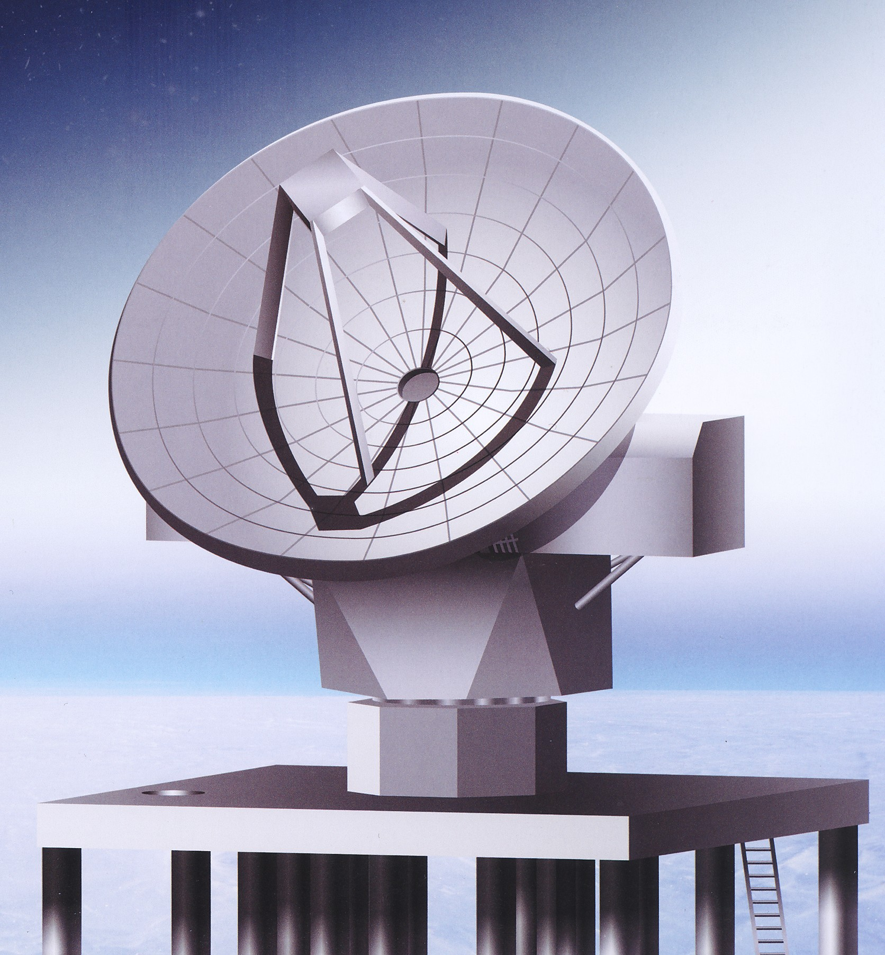
Summary
Lines in the THz region
  World of mainly atoms and light molecules
    In addition “slow vibration” of mainly long molecules
Science cases
  Basic chemical network
    Deuterium concentration
    Behavior of noble gases (relatively low excitation)
  Tracers of AGN (XDR)
  Tracers of shocks
  Atomic diffuse phase
  Carbon-chain molecules (no dipole moment in relatively low excitation)

